Slide 1


Overview
Microsoft Power BI Data Analyst
25-29 Apr '22
Time: 2:30 pm to 6:30pm GMT+5:30 (IST)
Munish Arora
(Microsoft Certified Trainer)
Please mute yourself. Thank you!

Slide 2
Learning Objectives
You will learn the following concepts:
What is Power BI
Architecture
Power BI Desktop
Data Sources (SQL Server, Sharepoint, etc.)
Notes:
By the end of this module, you’ll be able to:
Understand data analysis
Get started with Power BI

Slide 3
Module 1: Getting Started with Microsoft Data Analytics

Slide 4
Lesson 1: Data Analytics and Microsoft
Notes:
.

Slide 5
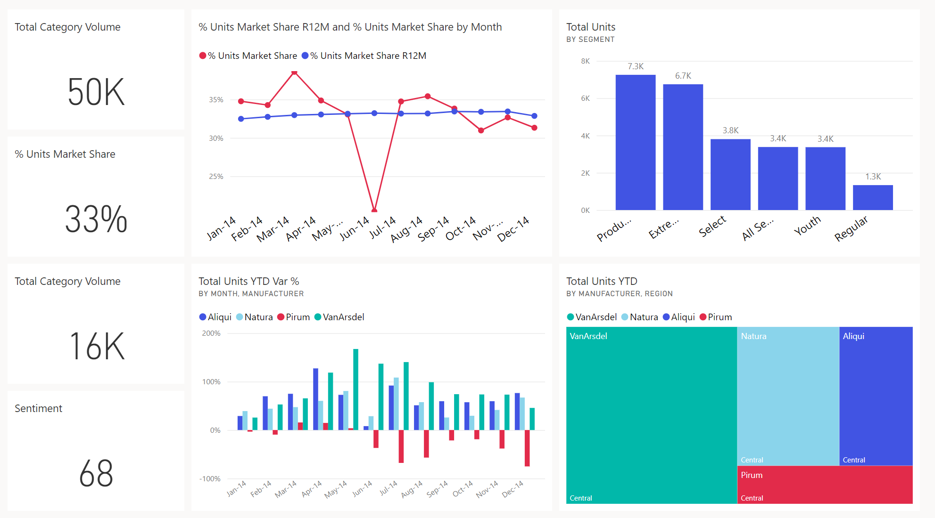



















Introduction
Data and information is the most strategic business asset.
Notes:
As a data analyst, you are on a journey. Think about all the data that is being generated each day and that is available in an organization, from transactional data in a traditional database, telemetry data from services you use, to signals you get from different areas like social media.
Businesses of today collect and store massive amounts of data. Yet, businesses continue to struggle to use their data in a meaningful and productive way, which impacts their ability to act. Business should be able to use their vast amounts of data and information in such a way that impacts the business.
Business decision makers depend on an accurate story to drive better business decisions. The faster a business can make precise decisions, the more competitive they will be and the better advantage they will have.
The key to unlocking all this data is being able to tell as story with it via compelling and insightful reports.
Your journey of telling a story with data also ties into building that data culture within your organization. While telling the story is important, where that story is told is also crucial, making sure the story is told to the right people.

Slide 6
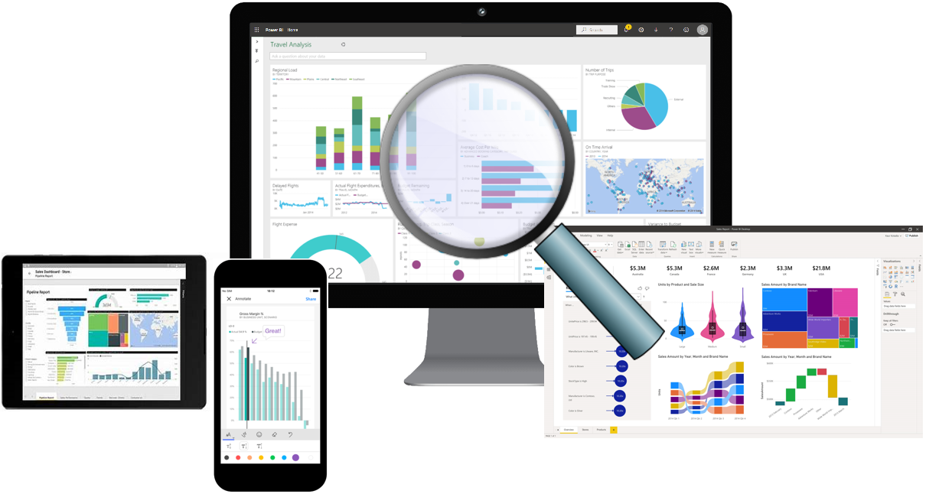
Overview of Data Analysis
Data Analysis is telling a story with data.
Five categories of analytics:
Descriptive
Diagnostic
Predictive
Prescriptive
Cognitive
Notes:
Before data can be used to tell a story, it must first be run through a process that makes it usable in the story. Thus, data analysis is the process of identifying, cleaning, transforming, and modeling data to discover meaningful and useful information. The data is then crafted into a story via reports for analysis to support the critical decision-making process.
While the process of data analysis focuses on the tasks of cleaning, modeling, and visualizing data, the concept of data analysis and how it is important to business should not be understated. To analyze data, core components of analytics are divided in the following categories:
As the world becomes more data-driven, storytelling through data analysis is becoming a more vital component and aspect of businesses large and small and is the reason organizations continue to hire data analysts.
Data-driven businesses make decisions based on the story their data tells, and in today's data-driven world, data is not being used to its full potential, a challenge that most business face today. Data analysis is and should be a critical aspect of all organizations to determine the impact to their business, including customer sentiment, market and product research, identify trends, or any other data insights.
Descriptive: Descriptive analytics helps answer questions about what has happened, based on historical data. Descriptive analytics techniques summarize large datasets to describe outcomes to stakeholders.
Diagnostic: Diagnostic analytics techniques supplement more basic descriptive analytics. They take the findings from descriptive analytics and dig deeper to find the cause. The performance indicators are further investigated to discover why they got better or worse.
Predictive: Predictive analytics techniques use historical data to identify trends and determine if they're likely to recur. Predictive analytical tools provide valuable insight into what may happen in the future.
Prescriptive: By using insights from predictive analytics, data-driven decisions can be made. This technique allows businesses to make informed decisions in the face of uncertainty.
Cognitive: Cognitive analytics helps you to learn what might happen if circumstances change, and how you might handle these situations, derive conclusions based on existing knowledge bases, and then add these findings back into the knowledge base for future inferences, a self-learning feedback loop.

Slide 7
Overview of Data Analysis
What is likely to happen in the future based on previous trends and patterns?
Determine best course of action to choose to bypass or eliminate future issues
Combines different technologies like artificial intelligence, machine-learning algorithms,
What is happening in my business?
Why it is happening in your business
Descriptive
Diagnostic
Predictive
Prescriptive
Cognitive
Descriptive analytics helps answer questions about what has happened, based on historical data
Diagnostic analytics techniques take the findings from descriptive analytics and dig deeper to find the cause.
Predictive analytics techniques use historical data to identify trends and determine if they're likely to recur.
Prescriptive Analysis, use insights from predictive analytics, data-driven decisions can be made.
Cognitive analytics helps you to learn what might happen if circumstances change and how you might handle these situations, derive conclusions based on existing knowledge bases
Notes:
Before data can be used to tell a story, it must first be run through a process that makes it usable in the story. Thus, data analysis is the process of identifying, cleaning, transforming, and modeling data to discover meaningful and useful information. The data is then crafted into a story via reports for analysis to support the critical decision-making process.
While the process of data analysis focuses on the tasks of cleaning, modeling, and visualizing data, the concept of data analysis and how it is important to business should not be understated. To analyze data, core components of analytics are divided in the following categories:
As the world becomes more data-driven, storytelling through data analysis is becoming a more vital component and aspect of businesses large and small and is the reason organizations continue to hire data analysts.
Data-driven businesses make decisions based on the story their data tells, and in today's data-driven world, data is not being used to its full potential, a challenge that most business face today. Data analysis is and should be a critical aspect of all organizations to determine the impact to their business, including customer sentiment, market and product research, identify trends, or any other data insights.
Descriptive: Descriptive analytics helps answer questions about what has happened, based on historical data. Descriptive analytics techniques summarize large datasets to describe outcomes to stakeholders.
Diagnostic: Diagnostic analytics techniques supplement more basic descriptive analytics. They take the findings from descriptive analytics and dig deeper to find the cause. The performance indicators are further investigated to discover why they got better or worse.
Predictive: Predictive analytics techniques use historical data to identify trends and determine if they're likely to recur. Predictive analytical tools provide valuable insight into what may happen in the future.
Prescriptive: By using insights from predictive analytics, data-driven decisions can be made. This technique allows businesses to make informed decisions in the face of uncertainty.
Cognitive: Cognitive analytics helps you to learn what might happen if circumstances change, and how you might handle these situations, derive conclusions based on existing knowledge bases, and then add these findings back into the knowledge base for future inferences, a self-learning feedback loop.

Slide 8
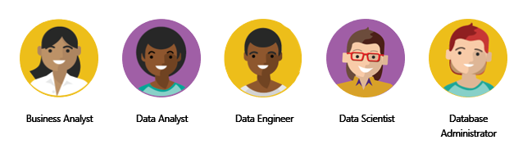
Roles in Data
Responsible for profiling, cleaning, and transforming data, designing, and building scalable and performant data models, and enabling and implementing the advanced analytics capabilities into reports for analysis.
DA-100
DP-203
DP-100
DP-300
Use of on-premises and cloud data services and tools to take, sending out, and transform data from multiple sources
A business analyst is closer to the business itself and is a specialist on interpreting the data that comes from the visualization.
Perform advanced analytics to extract value from data. Their work can vary from descriptive analytics to predictive analytics.
Notes:
As mentioned before, you are not alone. This is a journey and it usually doesn't start with you. The data must come from somewhere. And getting that data into a spot that is usable by you takes some effort and more than likely out of your scope. Especially when we think of the enterprise.
Today's applications and projects can be large and intricate, often utilizing the skills and knowledge of numerous individuals. Each person brings a unique talent and expertise to the table, working together and coordinating tasks and responsibilities in order to see a project through from concept to production.
Business analyst: While there are some similarities between a data analyst and business analyst, the key differentiator between the two roles is what they do with data. A business analyst is closer to the business itself and is a specialist on interpreting the data that comes from the visualization. Often the data analyst and business analyst could be the accountability of a single person.
Data analyst: Data analysts are responsible for profiling, cleaning, and transforming data, designing, and building scalable and performant data models, and enabling and implementing the advanced analytics capabilities into reports for analysis. Data analysts work with data engineers to determine and locate appropriate data sources and identify new processes or improve existing processes.
Data engineer: Primary responsibilities of data engineers include the use of on-premises and cloud data services and tools to ingest, egress, and transform data from multiple sources. They provision and set up data platform technologies that are on-premises and in the cloud. They manage and secure the flow of structured and unstructured data from multiple sources.
Data scientist: Data scientists perform advanced analytics to extract value from data. Their work can vary from descriptive analytics to predictive analytics. Descriptive analytics evaluate data through a process known as exploratory data analysis (EDA). Predictive analytics are used in machine learning to apply modeling techniques that can detect anomalies or patterns. These are an important part of forecast models.
Database administrator: A database administrator implements and manages the operational aspects of cloud-native and hybrid data platform solutions built on Microsoft Azure data services and Microsoft SQL Server. They are responsible for the overall availability and consistent performance and optimizations of the database solutions.

Slide 9
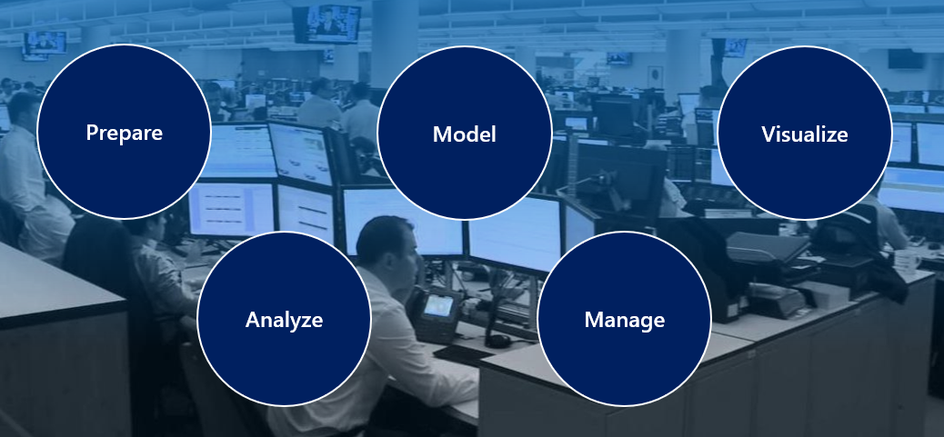
Tasks of a Data Analyst
Model is how your entities are related to each other
Model has a vital impact on application reporting and data analysis
Notes:
Now that you understand the who and the what, it's time to discuss the how. You already know that a data analyst is one of several critical roles in an organization, helping uncover and make sense of information to keep the company balanced and operating efficiently. As such, it's vital that you, as a data analyst, clearly understands your responsibility and the tasks that are performed on a near-daily basis. The skillset of a data analyst is essential in helping organizations gain valuable insights into the expanse of data they have, working closely with others in their respective roles in the organization to help bring to light valuable information.
Prepare: Data preparation is the process of profiling, cleaning, and transforming your data to get it ready to model and visualize. it takes raw data and turning it into information that is trusted and understandable. It involves, among other things, ensuring the integrity of the data, correcting wrong or inaccurate data, identifying missing data, converting data from one structure to another or from one type to another, or even something as simple as making data more readable.
Model: Once the data is in a proper state, it's ready to be modeled. Data modeling is the process of determining how your tables are related to each other. This is done by defining, and creating, relationships between the tables. From there, you can enhance the model by defining metrics and adding custom calculations to enrich your data.
Visualize: This task is where you get to bring your data to life! The goal of the visualize task is to ultimately solve business problems. A well-designed report should tell a compelling and impactful story about that data, enabling business decision makers to quickly gain needed insights. Using appropriate visualizations and interactions, an effective report guides the reader through the content quickly and efficiently, allowing the reader to follow a narrative into the data. The reports created during the visualization task help businesses and decision makers understand what that data means so that accurate and vital decisions can be made.
Analyze: The Analyze task is the important step of understanding and interpreting the information that is displayed on the report. In your role as a data analyst, you should understand the analytical capabilities of Power BI and use those to find insights, identify patterns and trends, predict outcomes, and then communicate those insights in such a way that everyone can understand. Advanced analytics enables businesses and organizations to ultimately drive better decisions throughout the business and create actionable insights and meaningful results.
Manage: There are many components in Power BI, including reports, dashboards, workspaces, datasets, and more. As a data analyst, you are responsible for the management of these Power BI assets, overseeing the sharing and distribution of items such as reports and dashboards, and ensuring the security of Power BI assets. The management of your content helps to foster collaboration between teams and individuals.

Slide 10
Review Questions
Q01 – Which data role enables advanced analytics capabilities through reports and visualizations?
A01 – Data Analyst
Q02 – Which data analyst task has critical performance impact on reporting and data analysis?
A02 – Model
Q03 – What is a key benefit of data analysis?
A03 – Informed business decisions.

Slide 11
Lesson 2: Getting Started with Power BI

Slide 12
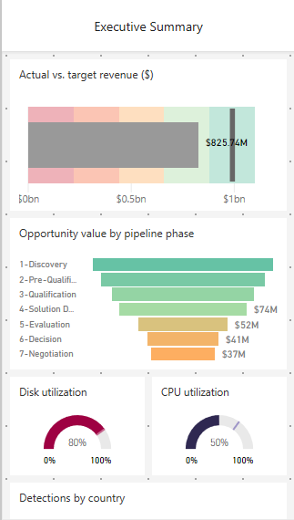
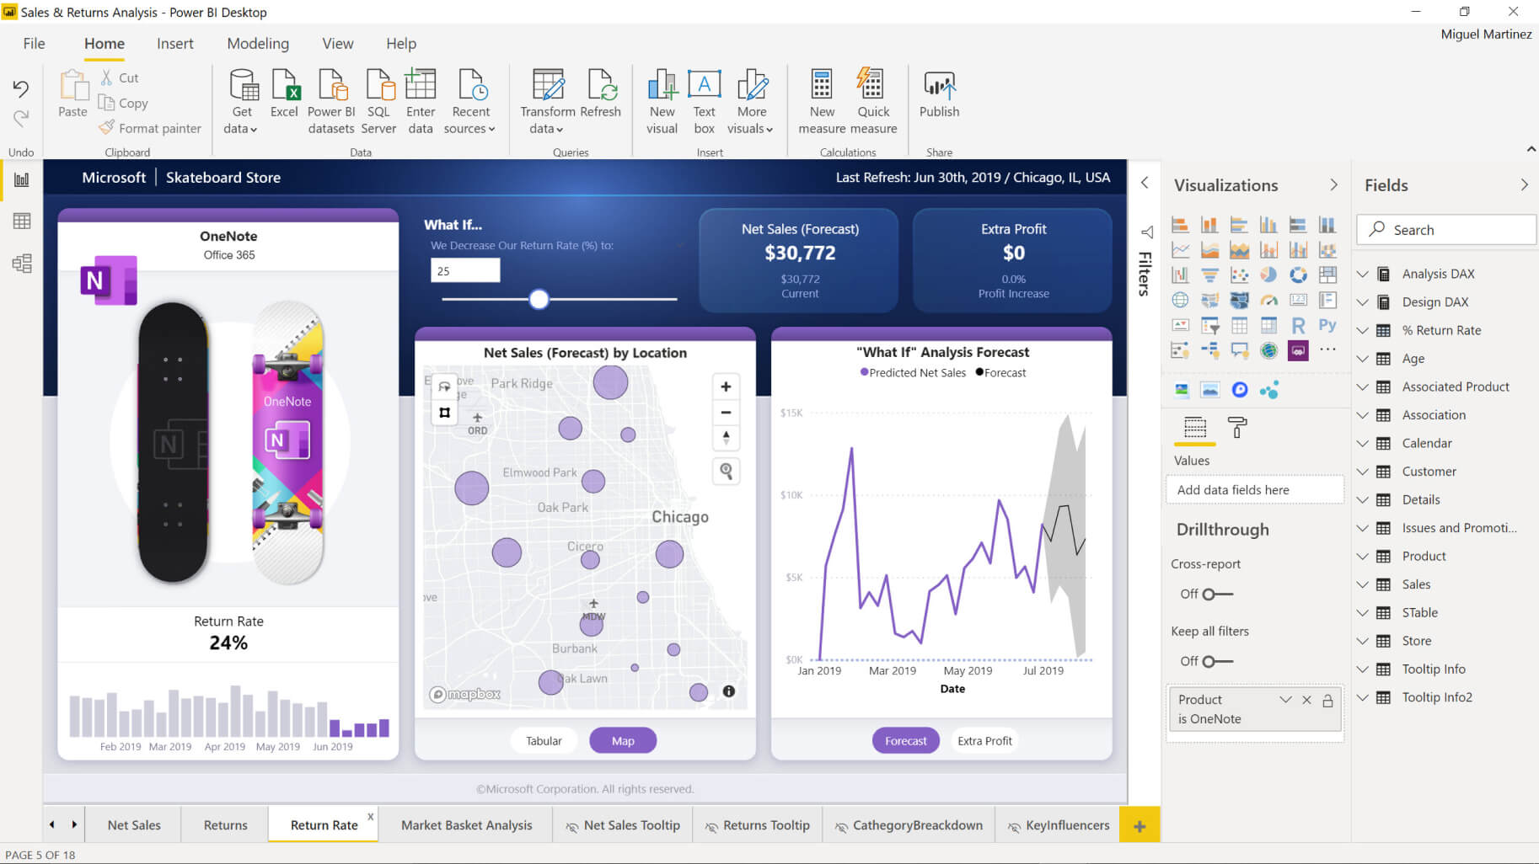
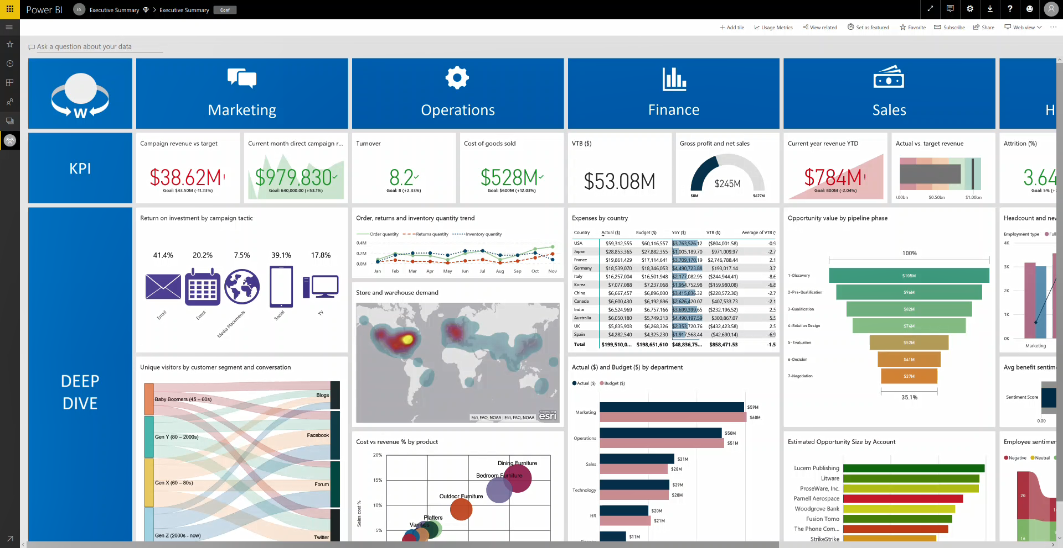
Introduction to Power BI
Power BI:
A collection of software, services, apps, and connectors.
Provides interactive visualizations with self-service BI capabilities , where end users can create reports and dashboards by themselves, without having to depend on any IT and Database administration.
Notes:
Microsoft Power BI is a collection of software services, apps, and connectors that work together to turn your unrelated sources of data into coherent, visually immersive, and interactive insights. Whether your data is a simple Microsoft Excel workbook, or a collection of cloud-based and on-premises hybrid data warehouses, Power BI lets you easily connect to your data sources, visualize (or discover) what's important, and share that with anyone or everyone you want.
Desktop: A free application you install on your local computer that lets you connect to, transform, and visualize your data.
Service: A SaaS service which brings together dashboards, workspaces, reports, and datasets for keeping a finger on the pulse of your business.
Mobile: Connect to and interact with your cloud and on-premises data. You create reports in Power BI Desktop. You create dashboards, and view dashboards and reports in the Power BI report service. You view on-premises Power BI reports on Power BI Report Server. All these reports and dashboards are available in the Power BI mobile apps, whether they're on premises or in the cloud.
How you use Power BI might depend on your role on a project or a team. And other people, in other roles, might use Power BI differently, which is just fine.
The flow of work in Power BI
A common flow of work in Power BI begins in Power BI Desktop, where a report is created. That report is then published to the Power BI service and finally shared, so that users of Power BI Mobile apps can consume the information.

Slide 13
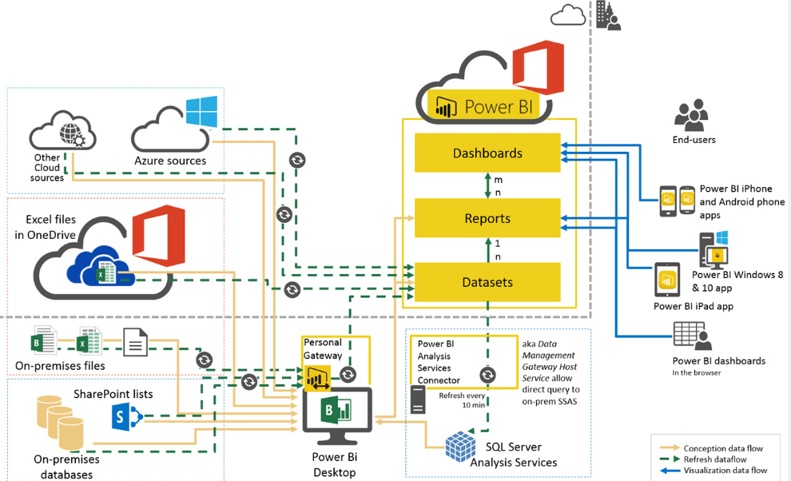
Architecture
A dataset is a collection of data that you import or connect to.
Notes:
Microsoft Power BI is a collection of software services, apps, and connectors that work together to turn your unrelated sources of data into coherent, visually immersive, and interactive insights. Whether your data is a simple Microsoft Excel workbook, or a collection of cloud-based and on-premises hybrid data warehouses, Power BI lets you easily connect to your data sources, visualize (or discover) what's important, and share that with anyone or everyone you want.
Desktop: A free application you install on your local computer that lets you connect to, transform, and visualize your data.
Service: A SaaS service which brings together dashboards, workspaces, reports, and datasets for keeping a finger on the pulse of your business.
Mobile: Connect to and interact with your cloud and on-premises data. You create reports in Power BI Desktop. You create dashboards, and view dashboards and reports in the Power BI report service. You view on-premises Power BI reports on Power BI Report Server. All these reports and dashboards are available in the Power BI mobile apps, whether they're on premises or in the cloud.
How you use Power BI might depend on your role on a project or a team. And other people, in other roles, might use Power BI differently, which is just fine.
The flow of work in Power BI
A common flow of work in Power BI begins in Power BI Desktop, where a report is created. That report is then published to the Power BI service and finally shared, so that users of Power BI Mobile apps can consume the information.

Slide 14


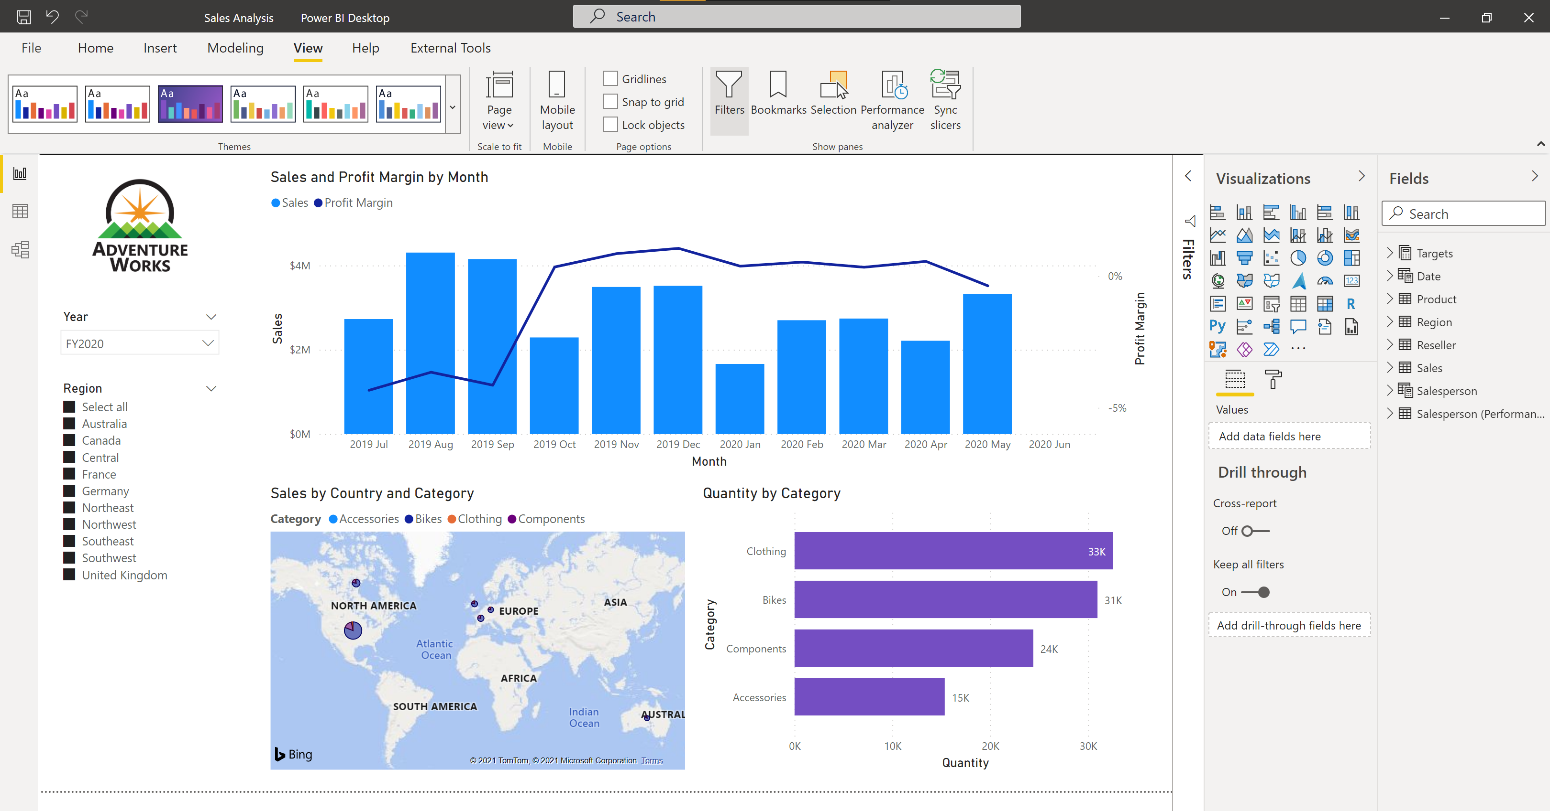




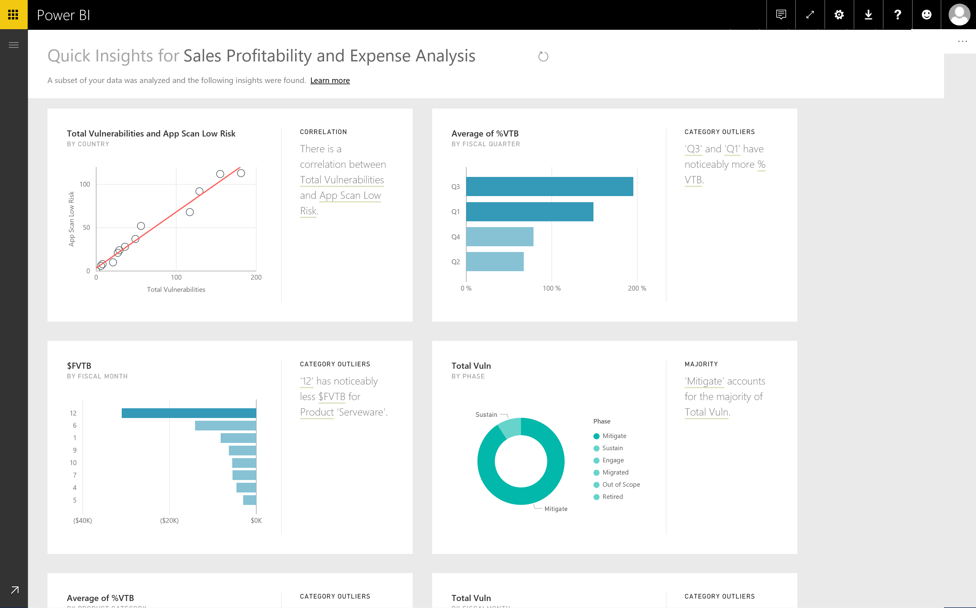
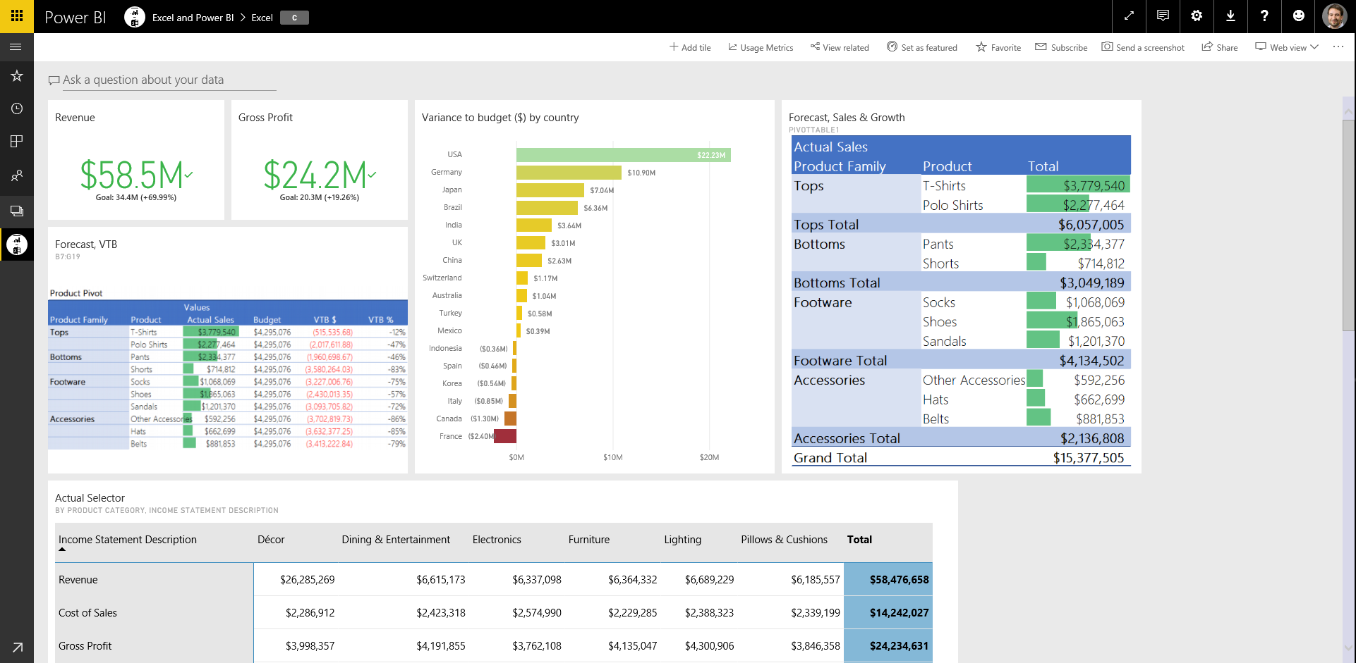
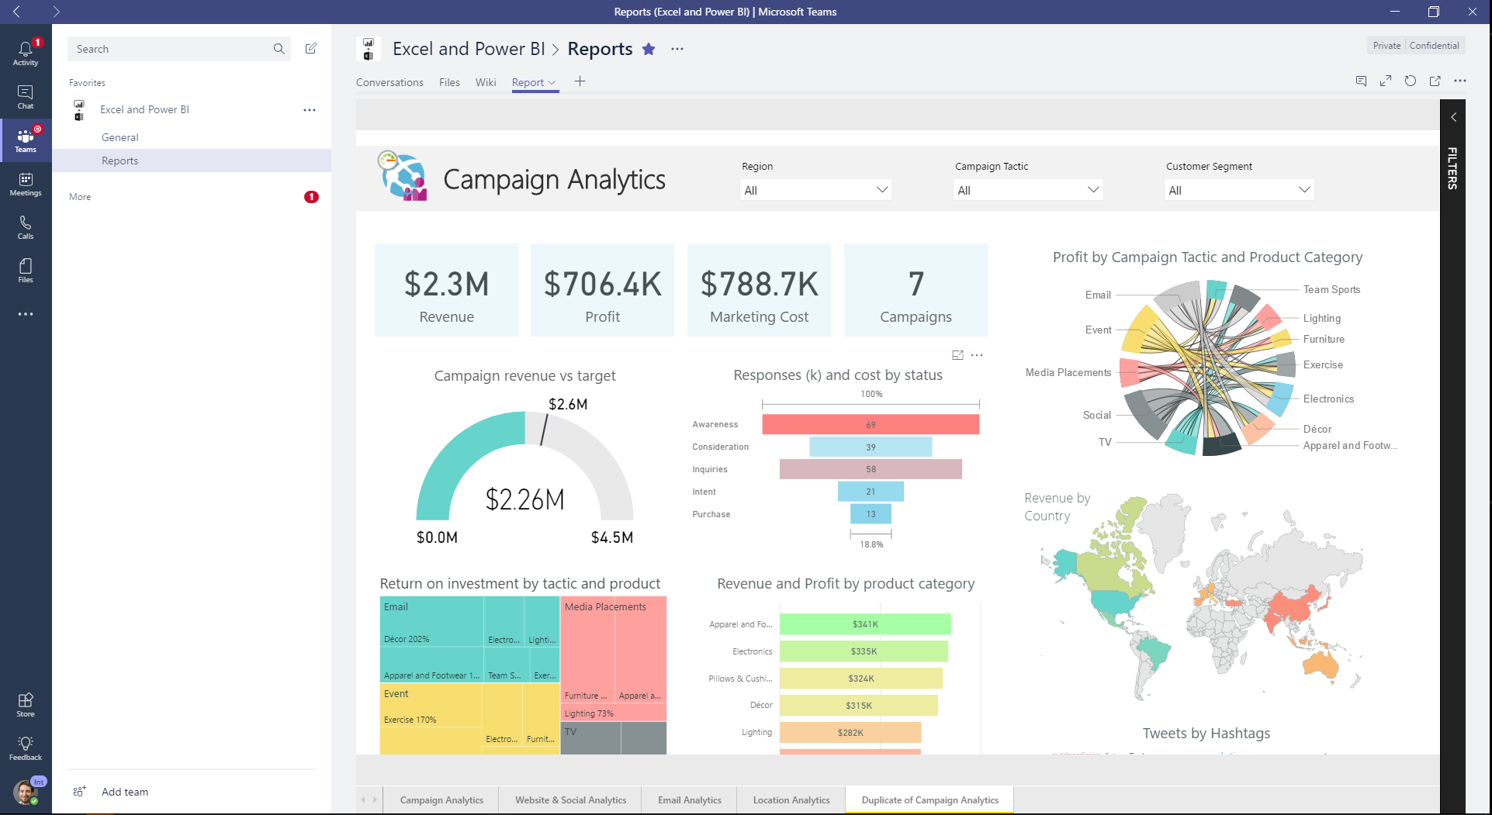
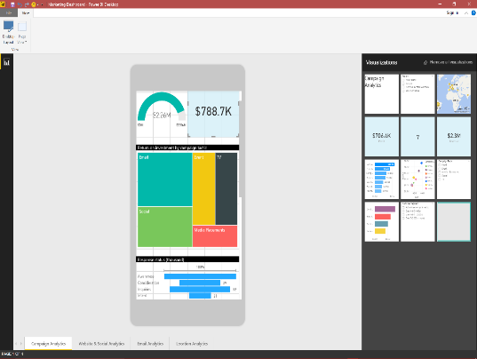

Use Power BI
Notes:
As a data analyst, the activities and analysis that you will learn and use with Power BI typically follow a common flow.
Bring data in to the Power BI where the data is cleaned, transformed, and modeled, and reports are created.
The reports are published to the Power BI service where you build dashboards or create new visualizations.
Share dashboards and other Power BI assets with others, especially people who are on the go.
View and interact with shared reports and dashboards in the Power BI mobile apps.
You might spend all your time in the Power BI service, viewing visuals and reports that have been created by others. And that's fine. Someone else on your team might spend their time in Power BI Desktop, which is fine too. To help you understand the full continuum of Power BI and what it can do, we'll show you all of it. Then you can decide how to use it to your best advantage.

Slide 15
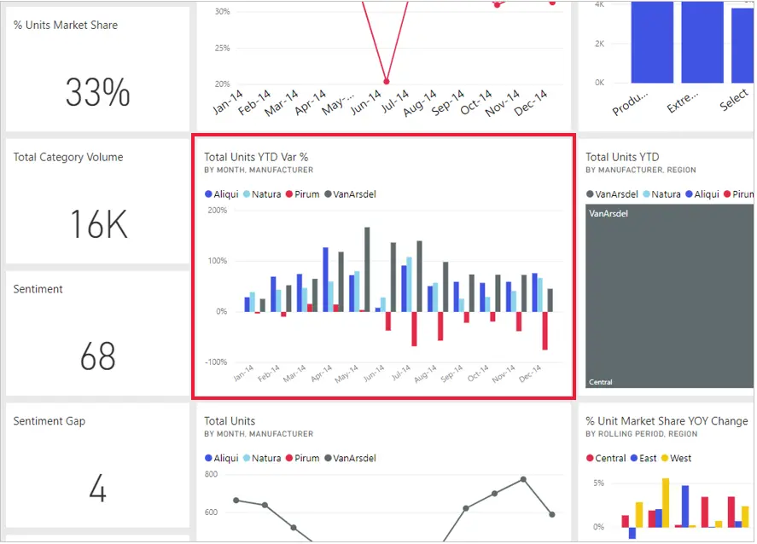
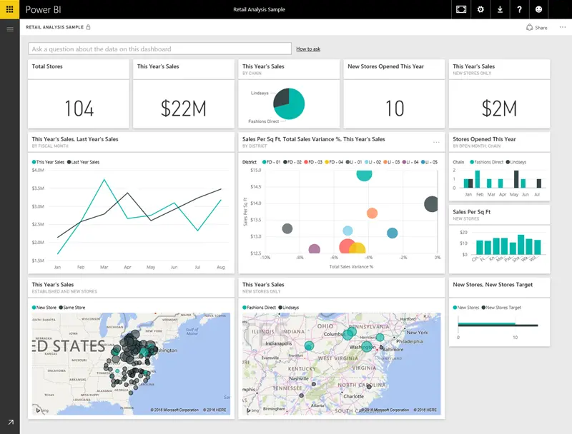
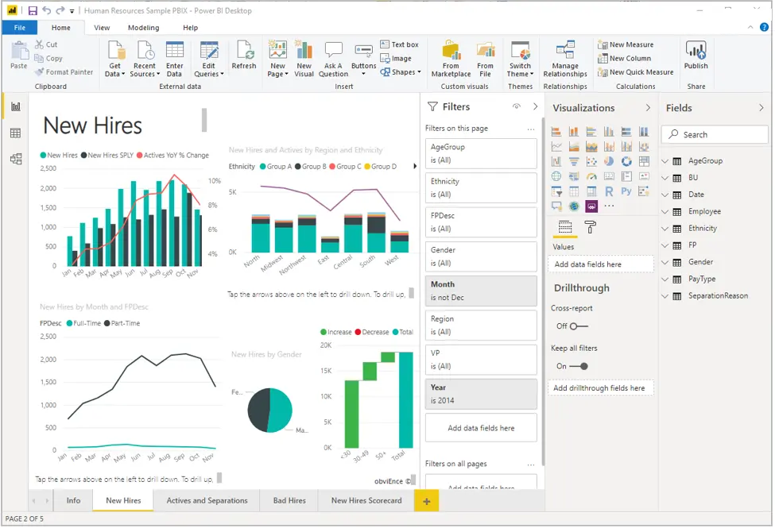
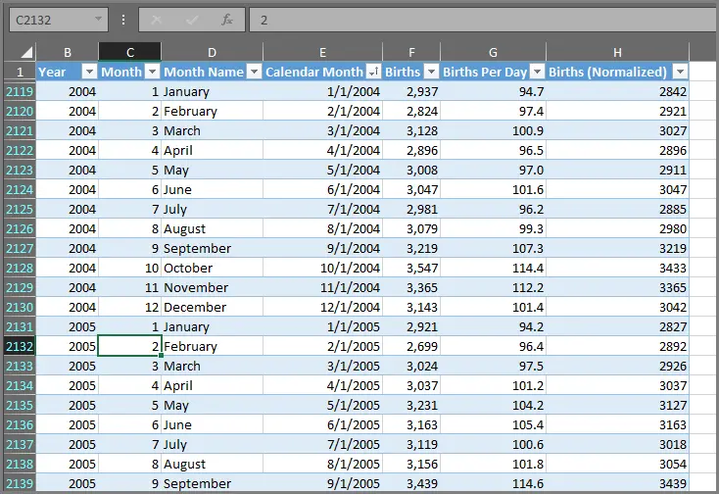
Building Blocks of Power BI
Visualizations
Dashboard and Tiles
Datasets
Reports
Notes:
Everything you do in Microsoft Power BI can be broken down into a few basic building blocks. After you understand these building blocks, you can expand on each of them and begin creating elaborate and complex reports. Let’s explore the basic building blocks, discuss some simple things that can be built with them, and then get a glimpse into how complex things can also be created.
Visualizations: Sometimes also referred to as a visual, it is a visual representation of data, like a chart, a color-coded map, or other interesting things you can create to represent your data visually. Power BI has all sorts of visualization types, and more are coming all the time. The following image shows a collection of different visualizations that were created in the Power BI service.
<CLICK>
Datasets: A collection of data from a combination of many different sources which you can filter and combine to provide a unique collection of data (a dataset) used to create visualizations.
<CLICK>
Reports: A collection of visualizations that appear together on one or more pages.
<CLICK>
Dashboards: A collection of visuals from a single page that you can share with others. Often, it's a selected group of visuals that provide quick insight into the data or story you're trying to present.
<CLICK>
Tiles: A single visualization on a report or a dashboard. It's the rectangular box that holds an individual visual.

Slide 16
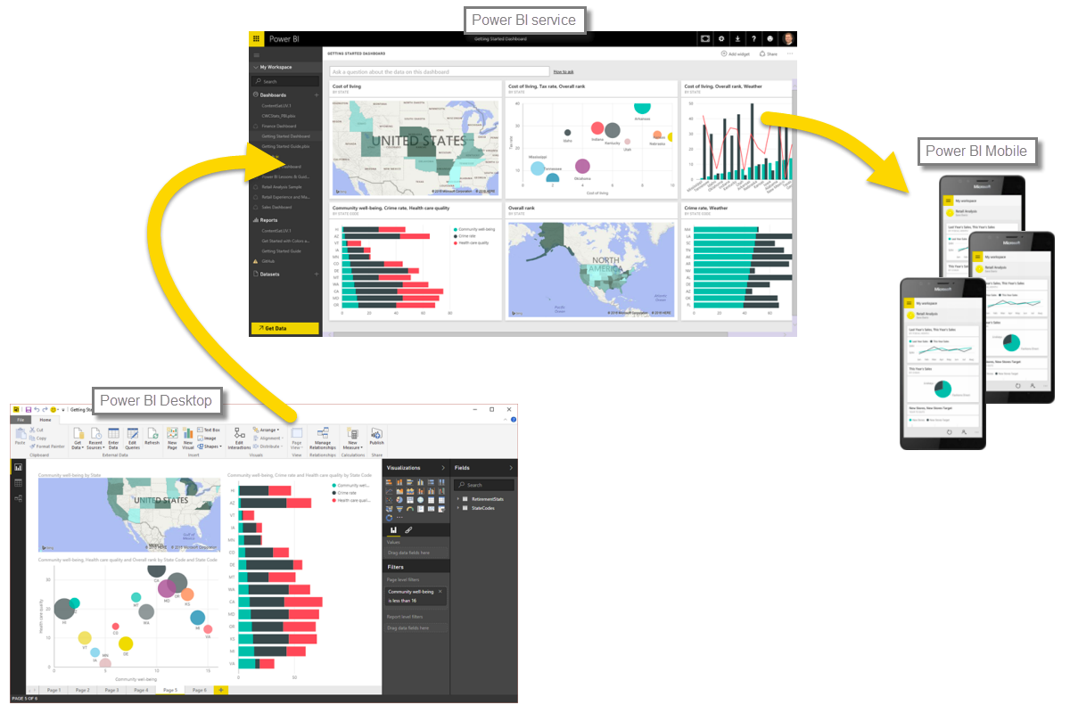
Common Flow Of Activity
The common flow of activity in Power BI looks like this:
Bring data into Power BI Desktop
Create a report
Publish to the Power BI service
In Power BI Service, you can create new visualizations or build dashboards.
Share dashboards with others, especially people who are on the go.

Slide 17
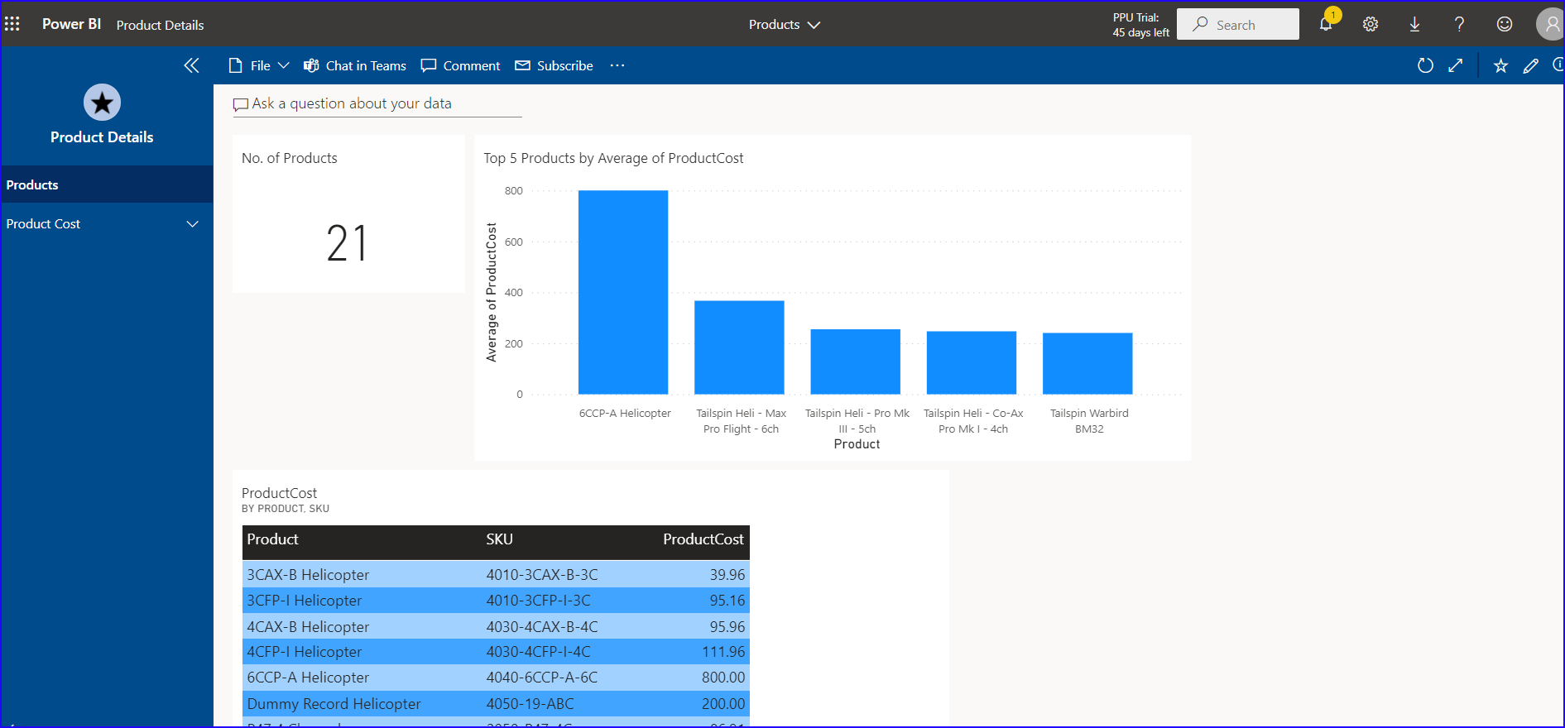
Power BI App
Creation /Use of Power BI App requires Power BI Pro Subscription
Power BI App is a collection of ready-made visuals, pre-arranged in dashboards and reports
Notes:
The common flow of work in Microsoft Power BI is to create a report in Power BI Desktop, publish it to the Power BI service, and then share it with others, so that they can view it in the service or on a mobile app.
But because some people begin in the Power BI service, let’s get an overview of that first, and learn about an easy and popular way to quickly create visuals in Power BI: apps.
An app is a collection of preset, ready-made visuals and reports that are shared with an entire organization. Using an app is like microwaving a TV dinner or ordering a fast-food value meal: you just have to press a few buttons or make a few comments, and you're quickly served a collection of entrees designed to go together, all presented in a tidy, ready-to-consume package.
The canvas (the area in the center of the Power BI service) shows you the available sources of data in the Power BI service.
There are apps for all sorts of online services.
Update data in the Power BI service
You can also choose to update the dataset for an app, or other data that you use in Power BI.

Slide 18
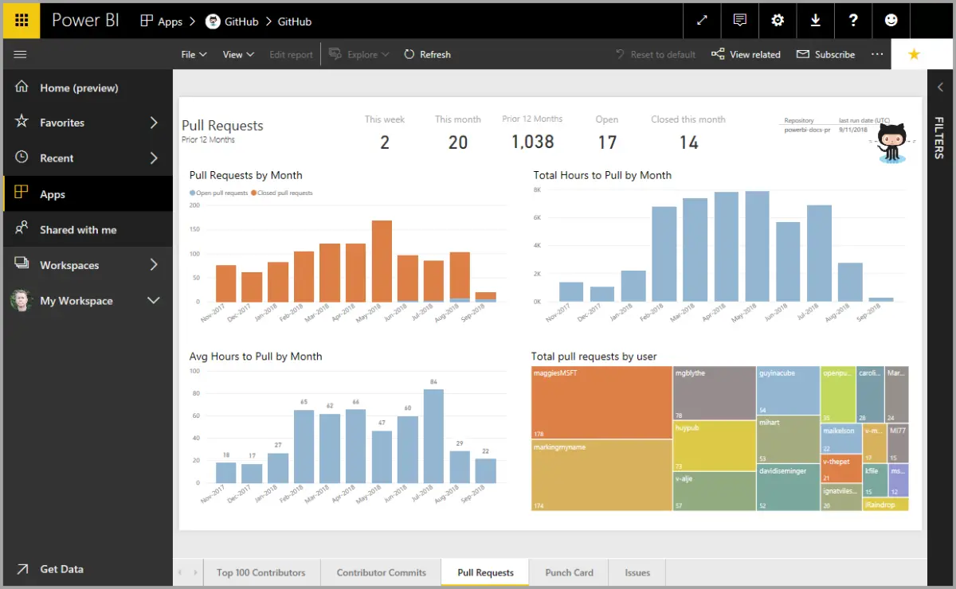
Touring and Using Power BI
Notes:
The common flow of work in Microsoft Power BI is to create a report in Power BI Desktop, publish it to the Power BI service, and then share it with others, so that they can view it in the service or on a mobile app.
But because some people begin in the Power BI service, let’s get an overview of that first, and learn about an easy and popular way to quickly create visuals in Power BI: apps.
An app is a collection of preset, ready-made visuals and reports that are shared with an entire organization. Using an app is like microwaving a TV dinner or ordering a fast-food value meal: you just have to press a few buttons or make a few comments, and you're quickly served a collection of entrees designed to go together, all presented in a tidy, ready-to-consume package.
The canvas (the area in the center of the Power BI service) shows you the available sources of data in the Power BI service.
There are apps for all sorts of online services.
Update data in the Power BI service
You can also choose to update the dataset for an app, or other data that you use in Power BI.

Slide 19
Review Questions (2)
Q01 – What are the building blocks of Power BI?
A01 – Visualizations, Datasets, Reports, Dashboards, and Tiles
Q02 – What is the common flow of activity in Power BI?
A02 – Bring data into Power BI Desktop and create a report, share it to the Power BI service, view and interact with reports and dashboards.
Q03 – What is a collection of ready-made visuals, pre-arranged in dashboards and reports is called?
A03 – An App

Slide 20
Lesson 1: Get data from various data sources

Slide 21
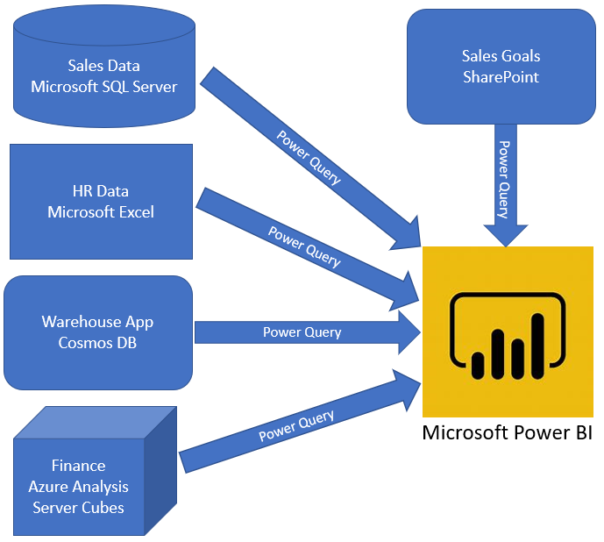
Introduction to getting data
The first step in the data analysis process is identifying and getting data.
Notes:
Like most of us, you work for a company where you are required to build Microsoft Power BI reports. The data resides in several different databases and files. These data repositories are different from each other, some are in Microsoft SQL Server, some are in Microsoft Excel, but all the data is related.
Before you can create reports, you must first extract data from the various data sources. Interacting with SQL Server is different from Excel, so you should learn the nuances of both systems. After you’ve learned the particulars of each system, you can use Power Query (the query engine used by Power BI and Excel) to help you clean the data, such as renaming columns, replacing values, removing errors, and combining query results.
After the data has been cleaned and organized, you are ready to build reports in Power BI. Finally, you will publish your combined dataset and reports to Power BI service (PBIS). From there, other people can use your dataset and build their own reports or they can use the reports that you’ve already built. Additionally, if someone else built a dataset that you'd like to use, you can build reports from that, too!

Slide 22
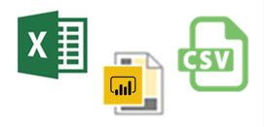
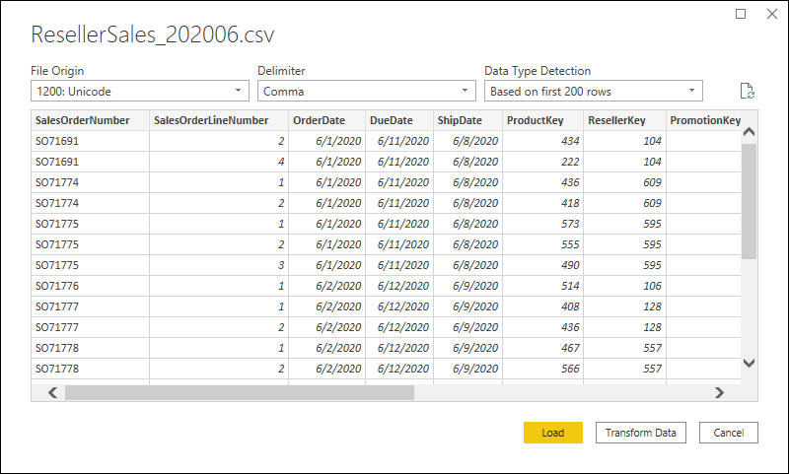
Get data from flat files
Notes:
Organizations often export and store data in files. One possible file format is a flat file. A flat file is a type of file that has only one data table and every row of data is in the same structure. The file does not contain hierarchies. Likely, you're familiar with the most common types of flat files, which are comma-separated values (.csv) files, delimited text (.txt) files, and fixed width files. Another type of file would be the output files from different applications, like Microsoft Excel workbooks (.xlsx). Power BI Desktop allows you to get data from many types of files.
Determine the location of the file: The first step is to determine which file location that you want to use to export and store your data (local, OneDrive, SharePoint).
Connect to the data file: On the Home tab, select Get data. In the list that displays, select the option that you require, such as Text/CSV or XML.
Select the data in the file to import: Select the check box(es) of the table(s) that you want to bring in to Power BI. This selection activates the Load and Transform Data buttons.
(Optional) Change the source file: You might have to change the location of a source file for a data source during development, or if a file storage location changes.
WARNING: If you are changing a file path, make sure that you reconnect to the same file with the same file structure. Any structural changes to a file, such as deleting or renaming columns in the source file, will break the reporting model.

Slide 23
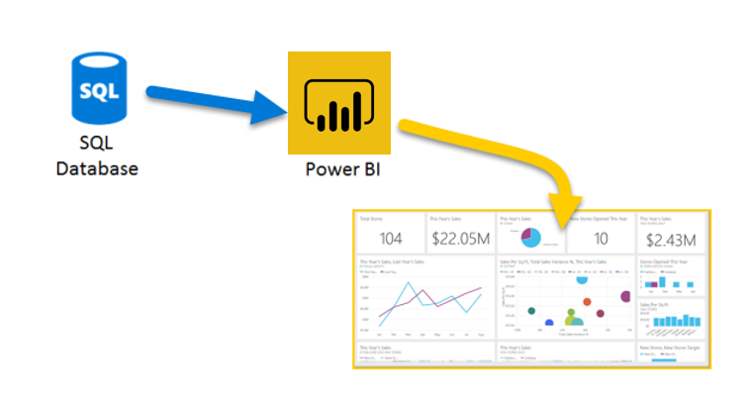
Get data from relational data sources
Notes:
If your organization uses a relational database to record its sales transactions, you can use Power BI Desktop to establish a connection to your organization's relational database, rather than getting data from individual flat files.
Connecting Power BI to your database will help you to monitor the progress of your business and identify trends, so you can forecast sales figures, plan budgets and set performance indicators and targets. Power BI Desktop can connect to many relational databases that are either in the cloud or on-premises.
Connect to the relational data store: Use Get data in Power BI Desktop and select the applicable option for your relational database.
Select the data to import: Select a table or entity to preview its contents and make sure that the correct data will be loaded into the Power BI model.
(Optional) Import data by writing a SQL Query: Another way you can import data is to write an SQL query to specify only the tables and columns that you need.
(Optional) Change data source settings: After you create a data source connection and load data into Power BI Desktop, you can return and change your connection settings at any time.

Slide 24
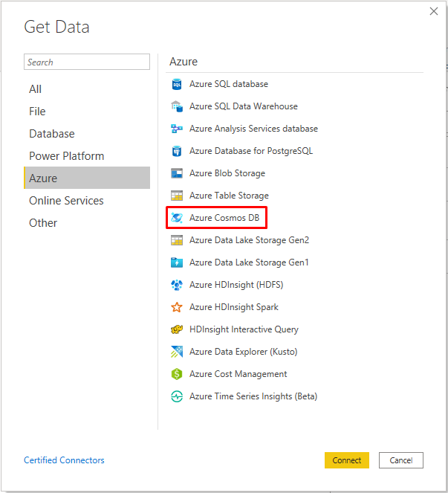
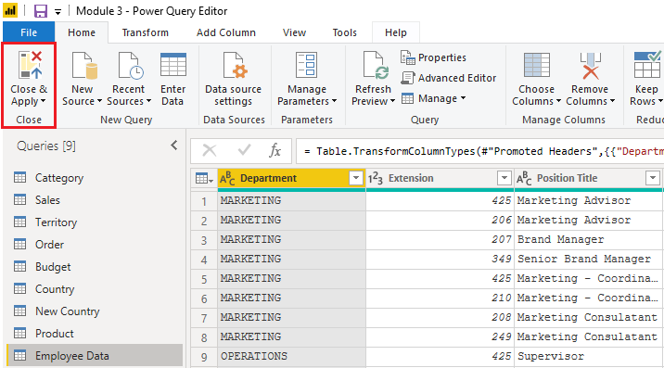
Get data from NoSQL
Notes:
Some organization don't use a relational database but instead use a NoSQL database. A NoSQL database (also referred to as non-SQL, not only SQL or non-relational) is a flexible type of database that does not use tables to store data.
Examples include Azure CosmosDB, Azure Blob/Table storage, MongoDB.
With Power BI and Power Query Editor, you can ingest NoSQL data which resembles a table with rows and columns, and relate that data to other data sources.
Connect to a NoSQL database: In Get Data, select the Azure category, select Azure Cosmos DB,and then select Connect.
Select the data: Select the table that you want to import. The preview pane only shows Record items because all records in the document are JSON documents and represented as a Record type in Power BI.
Review the selected data: To ensure you are satisfied with the data.
The data now resembles a table with rows and columns. Data from Cosmos DB can now be related to data from other data sources and can eventually be used in a Power BI report.

Slide 25
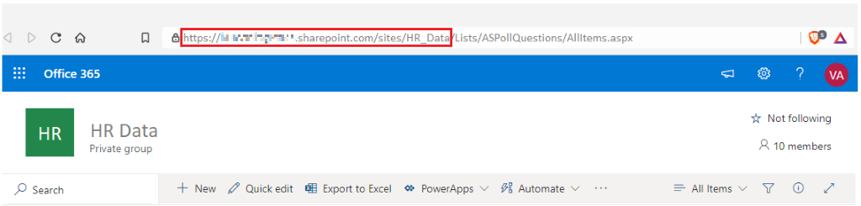
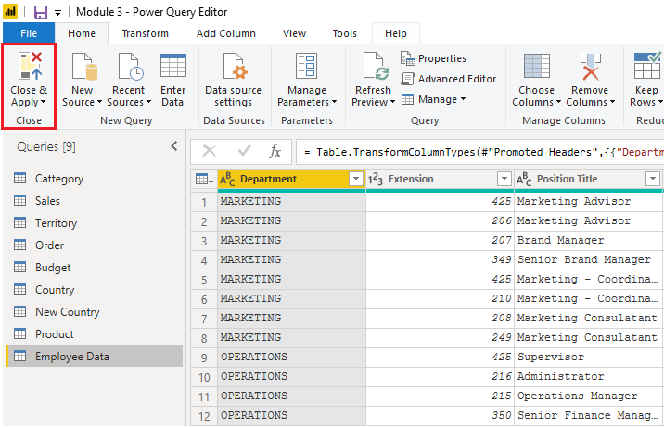
Get data from applications
Notes:
To support their daily operations, organizations frequently use a range of software applications, such as SharePoint, OneDrive, Dynamics 365, Google Analytics and so on. These applications produce their own data. Power BI can combine the data from multiple applications to produce more meaningful insights and reports.
When connecting to data in an application, you would begin in the same way as you would when connecting to the other data sources.
Connect to data in an application: Select the Get data feature in Power BI Desktop. Then, select the option that you need from the Online Services category.
Choose the application data to import: Select the list that you want to load into Power BI Desktop. Similar to when you import from other data sources, you have the option to automatically load your data into Power BI model or launch the Power Query Editor to transform your data before loading it.
When you are satisfied with your data, select the Close & Apply button to apply your changes and load your data into Power BI Desktop.

Slide 26
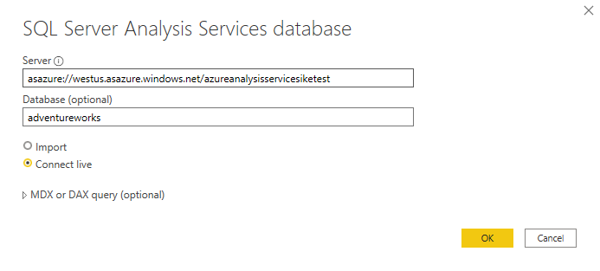
Get data from Analysis Services
An analytical data engine that lets you digest data from multiple data sources and create calculations on the fly.
Notes:
Azure Analysis Services is an Azure product that allows you to ingest data from multiple data sources, build relationships between the data, and creates calculations on the data. The calculations are built using data analysis expressions (DAX). Azure Analysis Services is similar to the data modeling and storage technology in Power BI.
Similar to a relational database, you can choose the tables that you want to use. If you want to directly query the Azure Analysis Services model, you can use DAX or MDX.
Notable differences between Azure Analysis Services cubes and SQL Server are:
Analysis Services cubes have calculations already in the cube, which will be discussed in more detail later.
If you don't need an entire table, you can query the data directly. Instead of using Transact-SQL (T-SQL) to query the data, like you would in SQL Server, you can use multi-dimensional expressions (MDX) or data analysis expressions (DAX).
You don't need to use the Get Data button in Power BI Desktop.
Getting data from AAS:
Connect to data in AAS: Use the Get data feature in Power BI Desktop. When you select Analysis Services, you are prompted for the server address and the database name with two options: Import and Connect live
Choose the tables you want to use: Similar to a relational database, you can choose the tables that you want to use. If you want to directly query the Azure Analysis Services model, you can use DAX or MDX.
Connect live is a new option in Azure Analysis Services. Azure Analysis Services uses the tabular model and DAX to build calculations, similar to Power BI.
Because you want to get data to other data in your organization , you will likely import the data directly into Power BI. An acceptable alternative is to import all other data that you want (from Excel, SQL Server, and so on) into the Azure Analysis Services model and then use a live connection. Using this approach, the data modeling and DAX measures are all performed in one place, and it's a much simpler and easier way to maintain your solution.

Slide 27
Module Overview
We covered the following concepts:
Data Analysis
How to get started with Power BI
Notes:
In this module we discussed:
Data Analysis
How to get started with Power BI

